Slide 1
Hidden slide: for presenter only
INTERNAL ONLY
Title:
Length:
Audience:
Presenter:
Purpose:
How to use:
Microsoft Office and Microsoft 365: Guide small businesses to the right solution
Expected presentation time is 40 minutes
Distribution and reseller partners
Microsoft or channel partner
Help existing and potential partners understand how they can grow their business by guiding very small businesses (under 25 employees) to the right solution based on where they are in their digital transformation journey
Deck may be presented 1:1 or 1:many. It can also be shared without presenting.
Use only the slides that are relevant for the partner conversation
Do not share slides marked “Disti” with anyone other than distribution partners
Please customize the slides with yellow boxes as indicated to fit your audience/market
Questions:
Contact Tamim Chowdhury: tamim.chowdhury@microsoft.com
Notes:
Presentation notes:
Do not show
Remove from all slides prior to sharing

Slide 2
Please Take Note
This slide is required for all partner facing decks.
Please delete this box but keep the slide.
The information in this presentation is Microsoft Confidential Information. Therefore, we remind you that you may not share this information with anyone outside your organization and only with those inside your organization who have a legitimate need to know.
This information is subject to change and should not be interpreted as an offer or commitment on the part of Microsoft.
Please no blogs, tweets, posts, or photos during the presentation as it can lead to loss of information and can easily be taken out of context.
Thank you.
Microsoft Confidential Information
Notes:
<Indicate that all information today is shared under non-disclosure agreement and representative of our current plan of record>

Slide 3
Microsoft Office and Microsoft 365:
Ramp to the cloud
Guide small businesses to the right solution
Q2 FY22

Slide 4

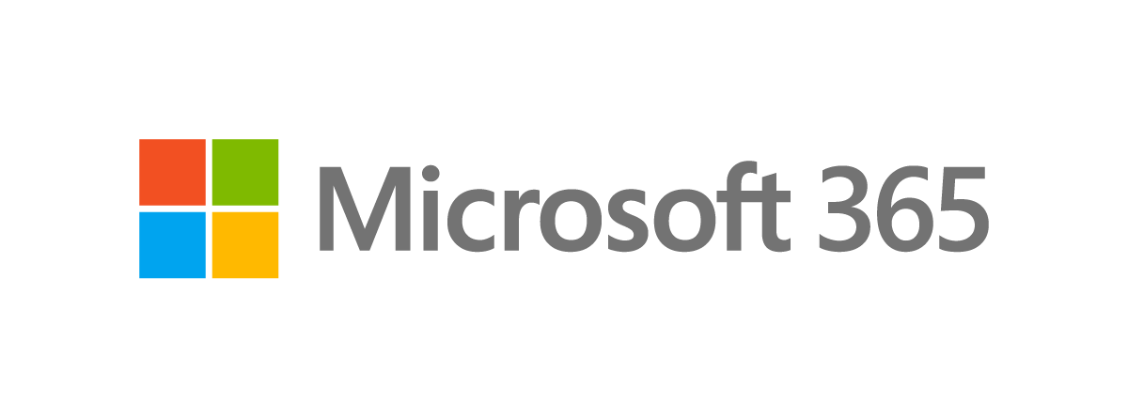
Contents
SMB overview
Microsoft solutions
Your opportunity
How to sell
Resources
Next steps

Slide 5

SMB overview

Slide 6

What do we mean by SMB?
Small and medium-sized businesses (SMBs) are the heart of the economy.
In the US alone, SMBs make up over 99% of all companies, and account, on average, for almost 50% of total employment and 44% of gross domestic product (GDP).¹
As SMBs across the globe seek to reimagine the way they work to accommodate new employee and customer expectations, Microsoft 365 and Microsoft Teams can deliver a secure, cost-effective, and easy-to-use collaborative solution.
¹SBA | Annual Report Of The Office Of Economic Research, FY 2019, Jan 21, 2021 - SBA defines small and medium-sized businesses (SMBs) to be companies with up to 500 people.
Microsoft Confidential - Shared Under NDA Subject to Change
Notes:
Entrepreneurship and small business creation is a key component of a thriving economy, with small and medium sized businesses (SMBs) accounting for almost 50% of employment in the US alone.¹ In today’s world, SMBs are looking for new ways to adapt to changing employee and customer expectations.
¹SBA | Annual Report Of The Office Of Economic Research, FY 2019, Jan 21, 2021 - SBA defines small and medium-sized businesses (SMBs) to be companies with up to 500 people.

Slide 7
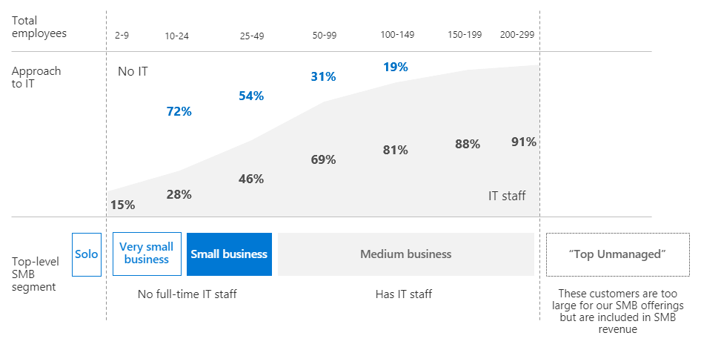
How SMB segments relate to number of employees and IT staff
Segments don’t exactly correlate to org size. But we use org size as a proxy because it is easy to measure (finance data, telemetry, quantitative research).
For this reason, we segment by solo (1 employee), very small (2-9), small (10-24), and medium (25-299).
Industry type makes a big difference. For example, a 50-employee restaurant is very different than a 50-employee investment firm.
Core target audience
Solo
Very small business
Small business
Source: SMB Security Survey: Quantitative Findings, June 2019, US and Europe
Microsoft Confidential - Shared Under NDA Subject to Change
Notes:
At Microsoft, we segment SMBs into four main categories, based on the # of employees and IT staff:
Solo: one person who sets up and runs a business on their own, including managing their own IT
Very small businesses: 2-24 employees; no full-time IT staff
Small businesses: 25-50 employees; no full-time IT staff
Medium businesses: 50-299 employees; has IT staff
In this presentation, we will be looking primarily at the needs of solo and very small businesses (those under 25 employees).

Slide 8
Each segment has distinct product needs
Core target audience
SMB Segments | Very small business 1-9 employees | Small business 10-24 employees | Medium business 25-300 employees
 | Mostly using consumer solutions | IT decisions ad hoc, heavily influenced by business owner | Approach IT intentionally with internal IT staff, dedicated budget
Business context | Majority work out of home, often part-time | Dedicated office, employees wearing multiple hats | Dedicated office(s), specialized roles
IT sophistication | No dedicated formal IT resources, 0-1 servers, basic consumer solutions | Low dedicated formal IT resources, 0-2 servers, low MDM, Identity Management | Dedicated IT resources/strategy, 6+ servers; ~40% using MDM, Identity Management
Telephony needs | Consumer telephony needs | Basic telephony needs | Advanced telephony needs
LOB app needs | Consumer productivity solutions for LOB needs | Horizontal productivity solutions for LOB needs | Paid specialized solutions
Channel | Web Direct, consumer brick and mortar, consumer e-tailers | Web Direct, consumer channels, resellers | Distributors, resellers, Web Direct
Purchase triggers | Performance issues, new devices | Performance issues, upgraded features/capabilities | Software compatibility, OS upgrade, new employee
Looking for | Price, convenience | Price, convenience | Performance, security, reliability
Alternatives to Microsoft 365 considered | Office Perpetual, Google Docs/Drive (free) | Office Perpetual, G Suite | Office Perpetual, G Suite
Source: Microsoft 365 SMB Storybook FY22, External
Microsoft Confidential - Shared Under NDA Subject to Change
Notes:
It can be tempting to fall into the trap of treating SMBs as one segment that’s all the same. It is true that SMB customers in general are different from enterprise customers. But SMB customers vary widely. For instance, a small bakery with 6 people has very little in common with a big medical supplier with 175 employees.
By grouping SMBs into similar groups based on their size and needs, we can do a better job at helping them find the right technology solution.

Slide 9



There is remarkable variety among small businesses customers
Local insurance agency | Real estate company | Independent consultant
18 | 7 | 1
Database management Cloud storage Industry-specific software Complying with industry regulations Securing confidential data | Seamless collaboration with clients from anywhere Ability to provide virtual tours to potential buyers Social media and industry-specific mobile apps Database management Securing confidential data | Seamless collaboration with clients from anywhere Industry-specific software Invoicing Controlling costs Complying with non-disclosure agreements
Dedicated office space with some remote employees | Dedicated office space but employees primarily work at home or while on the go | Works from home
IT managed by office manager | Some IT outsourced, but most managed ad hoc in-house | Solopreneur manages own IT
# of employees
Needs
Office location
IT situation
Notes:
These three small businesses are all under 25 employees, but each is substantially different:
The local insurance agency with 18 employees and an office space has an office manager who manages IT, in addition to other responsibilities. They need to comply with industry-specific regulations.
The real estate company has 7 employees who are extremely mobile and rarely in the office. Communicating with clients on the go is a top priority. They sometime outsource IT, but mostly do it ad hoc themselves.
The consultant owns and runs his own business with no employees. He works from home and manages his own IT. He needs to protect confidential data and ensure he can meet and collaborate with clients securely and professionally from anywhere.

Slide 10




Small and medium-sized businesses are reimagining work in the new normal
Work arrangements
76%
are adapting and enabling remote work¹
New tools
184%
Expected surge in video collaboration²
Security investments
11%
Expected YoY growth³
¹ AMI | Business Survey 2020: the impact of COVID-19 on SMBs in the USA - June 2020
² Techaisle | US SMB and Midmarket video collaboration adoption - March 2020
³ The impact of COVID-19 on SMB ICT demand - March 2020
Microsoft Confidential - Shared Under NDA Subject to Change
Notes:
SMBs all around the world are quickly pivoting in three key areas:
They are making new work arrangements for their employees and customers.
They are adapting new tools and ways to remain connected through online meetings and video conferencing.
And they are investing in Security – many small businesses were already exposed to security risks before the pandemic – and the switch to remote work increases this risk.
For instance, 76% of US companies have fully adapted to remote work, and the usage of video conferencing is projected to increase 184% post COVID-19. Globally, spending on cybersecurity is projected to grow 11% YoY in 2020—all part of an effort to secure cloud-based data and communications, and access to corporate networks.

Slide 11

Top challenges small and medium-sized businesses face today
Productivity
Need to enable remote and/or hybrid work scenarios
Getting work done securely from almost anywhere​
Maintaining employee efficiency and morale
Communication
Use of solutions that don’t play well together​
Lack of unified experience with meetings and calling​
Phone systems that weren’t designed to be used remotely
Security
Risk of cyberattacks and phishing threats​
Use of free or consumer solutions without robust security protections​
Employees accessing work data from personal devices
Microsoft Confidential - Shared Under NDA Subject to Change
Notes:
Specifically, we see customers face challenges in three key areas: productivity, communication, and security.
(Note to presenter: go over challenges, and ask the customer if this list resonates with them, or if there are new/additional challenges they face in these three areas)

Slide 12
Microsoft solutions

Slide 13

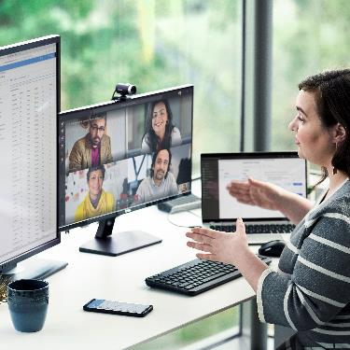

What if you could help your SMB customers . . .
Be more productive
wherever they and their employees are
Simplify meetings and calling
for employees, external partners, and clients
Secure their business
with trusted technology that helps them stay up to date on the latest security protocols
Microsoft Confidential - Shared Under NDA Subject to Change
Notes:
What if you were able to help your SMB customers, regardless of needs or size, use affordable technology to overcome their specific challenges? This includes the ability to:
Stay productive and get things done
Collaborate easily with other employees, external partners, and clients, wherever they are
Rest easy, knowing that their technology is protected with technology they trust

Slide 14




Securely work from anywhere with Microsoft 365 and Microsoft Teams
A cost-effective, cloud-based solution that helps your customers:
Be more productive almost anywhere
with real-time collaboration using videoconferencing, chat, calling, and email
Protect their business information with technology they can trust.
Optimize costs & management with a single, secure solution for teamwork.
Microsoft Confidential - Shared Under NDA Subject to Change
Notes:
With the right tools at hand, your SMB customers can increase productivity and grow their businesses. Microsoft 365 is a cost-effective cloud solution for real-time collaboration and secure work from anywhere. People can use it to chat, call, host online meetings, and collaborate in real time for remote and onsite work. It includes Microsoft Teams, cloud storage, and familiar Office apps with advanced security options.

Slide 15
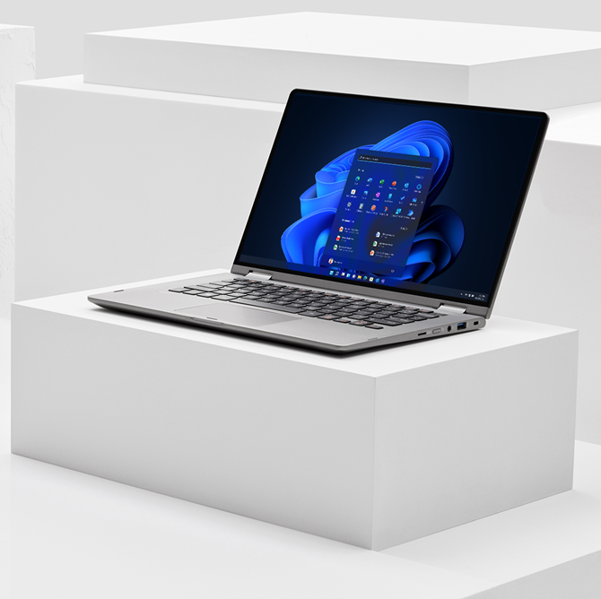
Helping small businesses modernize at their own pace
A small business may be ready to modernize their IT, but not yet ready to move to a cloud-based solution.
Even if they’re interested in the cloud, they may not be a good fit for a managed, ongoing subscription due to a limited budget and/or wanting to manage their own IT.
Microsoft has solutions to help customers at every stage of their digital transformation
Microsoft Confidential - Shared Under NDA Subject to Change
Notes:
While Microsoft 365 is the ideal solution to help small businesses overcome the challenges they’re facing today, not all SMBs are ready to move to the cloud. Some prefer to stay with a traditional model of “on-premise” computing where they purchase and own software outright. Or they may be interested in the cloud, but not ready to move to a partner-managed cloud solution due to budget constraints and/or the desire to manage their own IT. Microsoft offers a variety of solutions and ways to purchase technology to help customers modernize at their own pace.

Slide 16
A solution for every customer
Meet each customer where they are in their digital transformation journey
 | Customer profile | Solutions | Method of purchase
Classic On-premise | Wants a simple solution owned in perpetuity to support a capital expenditure (CapEx) buying strategy 25 employees or less | Microsoft Office Home & Business 2021 | Perpetual license via Full Packaged Product (FPP) or Electronic Software Distribution (ESD) One-time payment on your device Licensed per device
Transitional Customer-managed cloud | Interested in moving to the cloud, but not yet ready for a subscription model. Concerned about additional service fees and/or prefer to manage IT on their own. 25 employees or less | Microsoft 365 Business Standard Microsoft 365 Apps for Business | FPP or ESD Pay in full for one year, redeem online Licensed per user
Innovative Partner-managed cloud | Wants all the benefits of the cloud, partner-managed IT, and flexibility to upgrade or downgrade # of seats and/or SKU type For customers of any size who want the above benefits | Microsoft 365 Business Basic Microsoft 365 Business Standard Microsoft 365 Business Premium Microsoft 365 Apps for Business | Cloud Solution Provider program (CSP) Ongoing subscription through partner Monthly billing Licensed per user
Microsoft Confidential - Shared Under NDA Subject to Change
Notes:
Microsoft offers different ways to purchase technology based on three stages of digital transformation:
Classic: at this stage, a customer wants an on-premise technology solution that they own outright in perpetuity. Microsoft Office Home & Business 2021 is the best solution for this customer. They can purchase it as a “full packaged product” (FPP) in the box or online via electronic software distribution (ESD). They make a one-time payment for each license, which is tied to one device.
Transitional: customers at this stage are ready for the cloud, but still want to manage their own IT and/or aren’t ready for an ongoing subscription. A one-year prepaid subscription to Microsoft 365 Business Standard or
Microsoft 365 Apps for Business is ideal for this customer. They can purchase a license for each user through FPP or ESD and pay in advance for one year.
Innovative: at this stage, a customer is ready for what we call “partner-managed cloud” where the partner deploys and manages their IT. They can upgrade or downgrade the # of users and/or the type of plan each user is on each month. They purchase a license for each user from a Microsoft partner through the Cloud Solution Provider (CSP) program and are billed monthly.

Slide 17







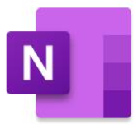





Microsoft 365 solutions for small businesses
Apps
Services
Microsoft 365 Business Basic
One-time purchase for 1 PC or Mac
¹
Word
Excel
PowerPoint
OneNote
Microsoft
Teams
OneDrive
Exchange
SharePoint
Microsoft 365 Business Standard
Cloud services and desktop apps
¹
Outlook
Word
Excel
PowerPoint
OneNote
Publisher
(PC only)
Access
(PC only)
Microsoft
Teams
OneDrive
Exchange
SharePoint
Microsoft 365 Business Premium
Cloud services and desktop apps
¹
Outlook
Word
Excel
PowerPoint
OneNote
Publisher
(PC only)
Access
(PC only)
Microsoft
Teams
OneDrive
Exchange
SharePoint
Intune
Information Protection
Microsoft 365 Apps for business
Desktop apps
Outlook
Word
Excel
PowerPoint
OneNote
Publisher
(PC only)
Access
(PC only)
OneDrive
For pricing information, go here.
For licensing information, go here.
To learn more about enterprise solutions go here.
¹ Microsoft Teams is also available separately for free.
Microsoft Confidential - Shared Under NDA Subject to Change
Notes:
For customers interested in the cloud, there are four Microsoft 365 solutions to choose from:
Microsoft Business Basic: includes chat, call, and meetings with up to 300 attendees; web versions of Office apps; 1 TB of cloud storage; business-class email; standard security; anytime phone and web support
Microsoft 365 Business Standard: includes everything in Business Basic, plus Desktop versions of Office apps with premium features and the ability to manage customer appointments
Microsoft 365 Business Premium: includes everything in Business Standard, plus advanced security, access and data control, and cyberthreat protection
Microsoft 365 Apps for business: includes desktop versions of Office apps with premium features, 1 TB of cloud storage, standard security, anytime phone and web support

Slide 18
Microsoft Office solutions for home and small businesses
Apps
Services
Office Home & Student 2021
One-time purchase for 1 PC or Mac
Word
Excel
PowerPoint
OneNote
Office Home & Business 2021
One-time purchase for 1 PC or Mac
¹
Outlook
Word
Excel
PowerPoint
OneNote
Teams
Office Professional 2021
One-time purchase for 1 PC
¹
Outlook
Word
Excel
PowerPoint
OneNote
Publisher
(PC only)
Access
(PC only)
Teams
¹ Microsoft Teams is also available separately for free.
For more information on each solution visit:
Office Home & Student; Office Home & Business, Office Professional.
Microsoft Confidential - Shared Under NDA Subject to Change
Notes:
For customers who are not yet ready to move to the cloud, Office 2021 is the best solution. Office 2021 is sold as a one-time purchase, which means customers pay a single, up-front cost to get Office apps for one computer. There are three versions of Office 2021 available:
Office Home & Student 2021
Office Home & Business 2021
Office Professional 2021

Slide 19
Three ways to purchase
Classic and Transitional
Innovative
1
Full Packaged Product (FPP)
2
Electronic Software
Distribution (ESD)¹
3
Cloud Solution Provider program (CSP)
One-time purchase at retail
Sold in shrink-wrapped boxes
Includes media
(CD-ROM or DVD)
For customers requiring
5 licenses or less
One-time purchase via the
Microsoft or partner website
A product code for each license is delivered digitally at the time of sale
End user inputs codes into their device(s) to activate each license
Software can be instantly downloaded and activated 24/7
Ongoing subscription purchased through partner
Partner deploys software
and manages subscription
for customer
Ability to upgrade or downgrade plans and/or number of seats each month, as needs change
¹ For more information on ESD, visit here.
Notes:
As mentioned earlier, Microsoft Office and the Microsoft 365 one-year prepaid subscription can both be purchased in two ways, either 1) in the box as a “full packaged product” (FPP) or 2) online via electronic software distribution (ESD).
Customers who are want all the benefits of the cloud, more flexibility, and help managing their IT can purchase a monthly subscription to any of the four versions of Microsoft 365 we talked about earlier from a Microsoft partner via the Cloud Solution Provider (CSP) program.

Slide 20

Opportunity

Slide 21
Your regional markets may reveal an
even greater opportunity to modernize.
Understand your
market opportunity
APJ
APAC
India
Australia
Japan
Modern
23%
Modern
7%
Modern
23%
Worldwide
Office Home & Business
Active Users
Legacy
77%
Legacy
57%
Modern
43%
Legacy
77%
Legacy
93%
Modern
30%
EMEA
Legacy
70%
Western Europe
CEE
MEA
UK
France
Germany
Modern
12%
Modern
24%
Modern
25%
Modern
28%
Modern
31%
Modern
27%
Legacy
72%
Legacy
88%
Legacy
76%
Legacy
69%
Legacy
73%
Legacy
75%
NAM
LATAM
CGR
Modernize customers on legacy versions of Office by moving them to Office Home & Business 2021 or to the Microsoft 365 one-year prepaid subscription plan.
Canada
US
LATAM
Greater China
Modern
26%
Modern 33%
Modern
16%
Modern
14%
¹ Microsoft internal research, June 2021, Partner, please edit for your region, as appropriate
Legacy
74%
Legacy
67%
Legacy
84%
Legacy
86%
Notes:
Meeting customers where they are in their digital transformation journey can also help you grow your business. A significant number of Office Home & Business users worldwide are on legacy versions, so there is a huge opportunity right now to help those customers modernize their technology. And that opportunity is even larger now with the availability of Office 2021. You can move them to the newest version of Office or to Microsoft 365 via either the one-year prepaid subscription offer or CSP, depending on their needs.
Don’t miss out on significant revenue opportunities with perpetual and one-year prepaid subscription sales!

Slide 22
Boost your revenue by selling to more small businesses
“No seat left behind” approach:
  Migrate small business customers on legacy versions of Office Home & Business to newer versions of Office Home & Business or to Microsoft 365 via the one-year prepaid subscription offer
  Capture previously overlooked small business customers who want to manage their own IT and/or have limited
  IT budget
Gateway to the cloud:
  Microsoft 365 one-year prepaid subscription offers very small businesses an easy way to experience the benefits of Microsoft 365 and the cloud, opening the door to future partner opportunities for upselling, add-on services, etc.
  Very little effort for the partner
  Customers can self-serve by purchasing digitally through ESD (like redeeming a gift card)
Wants to manage own IT
Limited IT budget
Solo
Very Small business (2-9)
Small business (10-24)
Medium business
(25-299)
Classic (on-premise):
Office Home & Business 2021
Transitional (customer-managed cloud):
Microsoft 365 one-year prepaid subscription
Notes:
It can be easy to overlook very small businesses as a valuable opportunity, as they aren’t always ready for the cloud and/or partner-managed IT. However, by taking the “no seat left behind” approach and being aware of all the options Microsoft has for SMBs, you can capture more customers and boost your revenue.
The Microsoft 365 one-year prepaid subscription also provides a great way to get customers introduced to the cloud, opening the door for future upsell opportunities.

Slide 23








Sell faster and more efficiently with ESD!
Instant
electronic delivery
Always available
Increased profitability
Electronic software distribution (ESD) offers partners clear advantages compared to traditional software sales and fulfillment. Shipping boxes can’t compare to offering your customers 24/7 availability and instant delivery of their orders. ESD is the modern way to sell.
Risk-free assortment of premium SKUs
Closer business alignment with Microsoft and resellers
No inventory or return costs
Increased reach & up sell and cross sell
Rich channel incentives and higher margins
Simplified Customer Relationship Management (CRM)
For more information on ESD, visit: https://devicepartner.microsoft.com/en-us/assets#/?search=esd
Microsoft Confidential - Shared Under NDA Subject to Change
Notes:
As we’ve already discussed, Microsoft Office and Microsoft 365 can both be purchased as a traditional full packaged product (FPP) or digitally through electronic software distribution (ESD). Selling digitally through ESD offers many benefits that can help you grow your business, including:
No inventory carrying costs or risk of theft/shrink
Fast delivery - Customers immediately download the product
Product is available for sale 24/7 online
Lower costs of delivery - Higher profitability
Greater opportunity to increase Reseller Reach and sales through CRM
Additional reach/market penetration
Closer business alignment with Microsoft — New sales models
No aging inventory – always current version of Office

Slide 24

How to sell

Slide 25
Buying journey: purchase triggers and barriers
Small and medium-sized businesses (SMBs) often delay upgrading their productivity suite until they absolutely have to upgrade.¹ When they do upgrade, key triggers include file sharing, remote access, and data security. ²
 | What triggers a purchase | What motivates a purchase | What prevents a purchase
Microsoft 365 | Remote access is a top trigger across SMBs of all sizes Small- and medium-sized businesses also cite planned upgrade, often of hardware | SMBs consider Microsoft 365 more scalable than G Suite | SMBs of all sizes cite security concerns Lack of good third-party reviews Small businesses find Microsoft 365 functionality too overwhelming, while medium- sized businesses reject it for not having enough
Microsoft 365 and G Suite | Security is important for eventual buyers Smaller businesses cite the need for more online file storage | Brand trust is the top motivator regardless of the brand chosen and segment, but even more so for smaller SMBs
G Suite | Cost is an important trigger Brand familiarity with consumer offerings also influence purchase | Recommendations by colleagues, employees, and peers are a strong motivator for small businesses. | Perceived to be low functionality by both small and medium SMBs Data storage is sticky and leads to perceived barriers against a different suite family
Office Perpetual |  | Small businesses default to Office perpetual because of familiarity and price; medium-sized businesses find it more compatible with their existing solutions
1 End of Support study, Sep 2018. 2 SMB Decision Journey., May 2018
Microsoft Confidential - Shared Under NDA Subject to Change
Notes:
Top SMB considerations for purchasing a new productivity include the need for remote access, security concerns, and cost.
SMBs are most often motivated to purchase by factors such as scalability, brand trust, peer recommendations, and familiarity.
Top factors that can prevent an SMB from purchasing are security concerns, lack of good third-party reviews, and the perception of either too much or not enough functionality.

Slide 26
Buying journey: SMB purchase journeys are short, relying on product comparisons
Top 10 steps in purchase journey
Feature evaluation becomes more important than price, with increase in the size of the business
Manufacturer website is one of the most important information sources across SMB types
IT partners play an important role for medium SMBs
The purchase journey lasts only 10 to 17 days depending on SMB size
I/we budgeted for this purchase
Visited the manufacturer website(s)
Online search via a search engine
Product feature comparison
Product price comparison
Online product demo
Talked with an IT partner about it
Organic search and online ads via a search engine
Read FAQs and other people’s Q&As
Specific product website page
SMB Decision Journey., May 2018
Microsoft Confidential - Shared Under NDA Subject to Change
Notes:
The SMB purchase journey is short (only 10-17 days) and relies heavily on product comparisons. Larger SMBs may consult with a partner, but very small businesses are more likely to gather information from online searches and manufacturer websites.

Slide 27
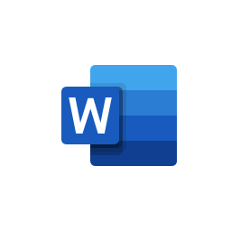
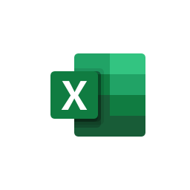



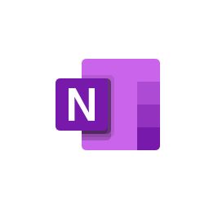



A journey to Modern Work with Microsoft 365
Get industry-leading apps combined with intelligent cloud services and world-class security
Apps
Services
Word
Excel
PowerPoint
Teams
Outlook
OneNote
OneDrive
SharePoint
1. Download & synch across up to five devices
6. Always on with 99.9% uptime guarantee
2. Detect threats early before issues occur
5. Save on Process Improvements
3. Simplify through vendor consolidation
4. Streamline IT Administration
Microsoft Confidential - Shared Under NDA Subject to Change

Slide 28
Office and Microsoft 365 purchase decision tree
Outlook
Word
Excel
PowerPoint
Publisher
(PC only)
Access
(PC only)
OneDrive
Partner-managed IT
Flexibility to adjust plan and/or # of seats monthly
Ideal for businesses 25+
Core apps
Cloud storage
Microsoft 365
apps for business
Innovative
CSP (monthly billing)
Core apps and services
24/7 support
Always up to date
Core apps
Cloud storage
Online chat, calling, video conferencing capability
Exchange Email
SharePoint
Microsoft 365
Business Standard
Manage own IT
Pay up front
Cloud-hesitant
Ideal for businesses <25
Transitional
One-year prepaid
Wants
Microsoft
Office
1
Core apps
Office Home & Business 2021
Outlook
Word
Excel
PowerPoint
Publisher
(PC only)
Access
(PC only)
OneDrive
Microsoft
Teams
Exchange
SharePoint
1
¹ Microsoft Teams is also available separately for free.
Word
Excel
PowerPoint
OneNote
OneDrive
Teams
Microsoft Confidential - Shared Under NDA Subject to Change
Notes:
When guiding an SMB customer to the right solution, ask probing questions at each step to understand their needs.
If they know that they want Microsoft Office and only core apps, then Office Home & Business 2021 is the right solution.
If they think they want Microsoft Office, but also want 24/7 support and always-up-to-date features, you can dig into the specific features that they want and guide them to the appropriate Microsoft 365 plan. Then you can guide them to either CSP or the one-year prepaid offer based on how they want to manage their IT, how much flexibility they need, etc.

Slide 29
Map customers to the right solution
 | Microsoft Office Home & Business 2021 | Microsoft 365 Business Standard Microsoft 365 Business Apps Prepaid one-year subscription | Microsoft 365 Business Standard Microsoft 365 Business Premium CSP
25 employees or less
Limited IT budget
OK with self-service install
ITDM is business owner
Small/home office (SOHO)
Only want core apps
Need partner-led IT/onboarding
Regulated industry
Values cloud services
Needs enterprise-grade services
Notes:
You can also ask questions around these factors to help guide customers to the right plan for them. See the “exploratory questions” slide later in this section for more specific questions.

Slide 30
Migrate customers to the cloud at their own pace
Classic
Microsoft Office Home & Business (legacy)
On Office Home & Business 2016 or older.
Wants updated features but not ready for cloud.
Office Home & Business 2021
Transitional
Office Home & Business (legacy or modern).
Wants cloud services features but not ready for ongoing subscription and/or partner-managed IT.
Microsoft 365 one-year prepaid
Microsoft 365 Business Standard
Microsoft 365 Apps for Business
Innovative
Office Home & Business or
Microsoft 365 one-year prepaid
Ready for partner-managed IT/services and more flexibility.
Microsoft 365 CSP
Microsoft 365 Business Basic
Microsoft 365 Business Standard
Microsoft 365 Business Premium
Microsoft 365 Apps for Business
Notes:
With the three types of Microsoft solutions, you can help customers move to the cloud at their own pace. Those on legacy versions of Microsoft Office Home & Business who aren’t ready for the cloud can move to Office Home & Business 2021. Customers on either legacy or current versions of Office Home & Business who are ready for cloud features, but not managed IT, can move to the Microsoft 365 one-year prepaid offer. And those who have tried the one-year prepaid cloud offer and are ready for partner-managed IT and more flexibility can transition to CSP.
A note about the Microsoft 365 one-year prepaid plan: when a customer is coming close to the end of their one-year subscription, they will get an automated email from Microsoft to renew. The email will point them to renew through the admin portal or online. Partners should track when they sold the subscription and proactively reach out to the customer at the time of renewal to encourage them to renew or even upgrade to CSP.

Slide 31
Exploratory questions to use with customers
How many employees do you currently have? Do you see that changing anytime soon?
How often do your employees work remotely, and what apps and video conferencing tools are they using?
How do your employees work together on documents or projects?
If they need to get answers quickly, what apps & devices do they use and how long does it take?
How has your business changed over the last year—and what goals do you have for the future?
How do you handle the security of the devices that your employees use to access company data?
Approximately how much time do you currently spend managing your IT?
What are some of your top IT costs?
When is your next software refresh, and are you considering any additional tools/capabilities?
If you had a wish list for your technology, what would it include?
What are some of the barriers you face in adopting new capabilities? Look for cost, skills, business risk, time, difficulty, etc.
Use these questions to understand the customer’s business needs and challenges
Notes:
These questions are designed to help you understand the customer’s business needs and challenges. Use any insights you’ve already gathered to focus on the most relevant topics.
Start by asking the leading questions and then use the follow-up questions to gather more insights, adjusting as needed based on what seems most relevant and how they respond. Ensure the customer feels heard and personalize your questions as needed.
Listen to their answers and take note of the areas where they seem to have the most needs/challenges, so you can steer the conversation towards the most relevant solution.

Slide 32
Handling objections from customers
Objection | Response
I’m satisfied with my desktop software - my employees have what they need. | Customers don’t like waiting, and you could be losing business with slow response times. Save 4 hours per week by finding the information and people you need in Microsoft Teams.¹ You can work on documents together, videoconference, chat, call and schedule meetings—all in the same location. Studies show that by sharing information with Teams, you and your employees can make key decisions up to 17.7% faster.¹
I like the idea of cloud apps, but I’m worried about security. | Did you know that 43% of breaches happen online through web apps, and 37% of breaches involve lost or stole credentials?² A breach can hurt your bottom line as well as your reputation. Microsoft security features can help safeguard your business. For example, multi-factor authentication can block 99.9% of identity attacks.³ Your business information can be kept securely in the cloud and accessed from nearly anywhere, helping you avoid expensive downtime due to security breaches, information loss, or hardware failure.
A lot is changing in the market right now. I’m not sure we can afford to start using a new tool. | A recent Forrester study shows that firms with Microsoft 365 for business gained up to 163% ROI over three years by improving employee productivity and reducing IT costs. Savings include $29 per user each month in technology expenses.⁴
We’re not a big company and don’t want to add IT complexity. | Save time with apps that are always up-to-date and managed for you. IT staff can save up to four hours each week, giving them more time for value-added activities.⁴ Get a platform that scales with you as business grows—with flexible plans and pricing, it’s easy to add new capabilities and services.
I’m fine with my older version of Office and don’t want to purchase new software. | Microsoft no longer supports Office 2007 or 2010. End of Support means no future security updates for older versions of Office. In order to help keep your data and business safe with the latest Office Classic apps, upgrading to Office Home & Business 2021 is recommended. Office Home & Business 2021 now has the modern lifecycle policy that gives you security and select feature updates.
Microsoft Confidential - Shared Under NDA Subject to Change
Citations to third party content published with permission of the author or publisher:
1) Total Economic Impact of Microsoft Teams, Forrester, 2019. Study commissioned by Microsoft.; 2) Verizon Data Breach Report 2020; 3) Requires Azure Active Directory with multi-factor authentication enabled; 4) The Total Economic Impact™ of Microsoft 365 for business, Forrester, 2020. Study commissioned by Microsoft
Notes:
These are some common customer questions/objections and how best to respond. This list is not exhaustive and can be adjusted as needed based on each customer/situation.

Slide 33
Handling objections from distributors and resellers
Objection | Response
Our business is going great selling CSP. Why should we focus on smaller customers/plans? | You’re leaving revenue on the table by not selling to smaller businesses who are not ready to move to a managed, ongoing cloud subscription due to a limited IT budget, preference for a capital expenditure purchasing model, and/or the desire to manage their own IT. Also, by providing customers with the best solution for them, you are building credibility as their trusted advisor. This may lead to future sales of products and services.
It’s not worth our time to set smaller customers up on Microsoft 365. | Customers who want the one-year prepaid subscription offer are typically willing to do the work themselves and you can make that easy for them with electronic software distribution (ESD). This enables customers to instantly download software digitally anytime, from anywhere with little-to-no effort on your part.
I’m not sure how to explain and set up the Microsoft 365 Business Standard one-year prepaid subscription offer. | Microsoft 365 Business Standard with MSA activation includes Word, Excel, PowerPoint, Outlook, OneNote, and OneDrive consumer. A domain is required to enable all other services, such as Exchange, Biz apps, Microsoft Teams, and OneDrive for Business. Set up is easy with a free GoDaddy domain for one year (more details here).
We’re focused on selling Microsoft 365. Why should we sell Office? | It's great that you’re focused on selling Microsoft 365, but you can also offer those customers that are not ready for a subscription or the cloud a great product and earn more revenue in the process. 70% of Microsoft Office users worldwide are on legacy versions of Office. This number is higher in some regions e.g., 93% in India, 86% in China, 84% in Latam.¹ This presents a huge opportunity to migrate these customers to Office Home & Business 2021, which launches in October 2021.
As a reseller, I don’t have enough time to grow my business and provide post-Office sales support. | With Office Home & Business 2021, we provide 60-day installation support post-sale at no additional cost so our SMB partners can focus on growing their business.
My customers are fine with an older version of Office and don’t want to purchase new software. | Microsoft no longer supports Office 2007 or 2010. End of Support means no future security updates for older versions of Office. 32% of SMBs want to keep up with security threats.² In order to help keep your data and business safe with the latest Office Classic apps, upgrading to Office Home & Business 2021 is recommended.
¹ Microsoft internal research, June 2021; ² Microsoft Market Research – Office Home & Business Small Business Research Report, Feb 2020.
Microsoft Confidential - Shared Under NDA Subject to Change
Notes:
You may encounter some of these objections from resellers to selling solutions other than CSP. Use the provided response to help guide your conversation and adjust as needed based on the specific situation.

Slide 34



















SMB competitive landscape
Productivity
Voice and meetings
Collaboration and chat
Security and management
Resources
Zoom Compete SMB Leave-Behind (commercial resource)
Google Compete SMB Leave-Behind (commercial resource)
Microsoft Confidential - Shared Under NDA Subject to Change
Notes:
These are some of the main competitors to Microsoft in four different categories: productivity, collaboration and chat, voice and meetings, and security and management. Visit the resource links for more information on how to position Microsoft solutions against some of these competitors.

Slide 35
Resources
End User/ Demand Gen (Digital & Print)
  Office Home & Business 2021 (Emails, Landing Pages, Social Media, PDP, Static & Animated Banners, Print)
Aided Sales (Sales Enablement)
  Office Home & Business 2021 To Reseller Pitch Deck
  Office Home & Business 2021 To Customer Pitch Deck
  Office Home & Business 2021 Infographic
  Office Home & Business 2021 Discussion Guide
  Office Home & Business 2021 Decision Tree
  Office Home & Business 2021 Product Guide
  Microsoft 365 Sales Enablement Assets
  Electronic Software Distribution (ESD) Sales Enablement Assets
Un-Aided Sales (Videos & DCCN)
  Office Home & Business 2021 Videos
Readiness (Training & ExpertZone)
  Office Home & Business 2021 Product Guide

Slide 36
Digital Support
Digital Billing/ Invoicing/Pricing/ Returns Queries
System & Operations
Escalations e.g. Digital service errors, token ordering activation, renewal/redemption issues
Customer Redemption/ Download/Install Support
Critical Production System Issue Support
Team:
MS Digital Operations
Coverage:
Global 24/5 (Mon-Fri)
Contact: digiops@Microsoft.com
SLA
72 hours
Team:
DSC Bus Ops Support
Coverage:
08:00 – 18:00 PST
Contact:
dscsup@microsoft.com
Team:
Microsoft Customer Service (CSS)
Coverage:
Global 24/7
Site:
support.microsoft.com/contactus/
Team:
OSOC (OneStore Operations Center)*
Coverage:
Global 24/7
Contact:
MUST complete below template & send to osoc@microsoft.com + DSCSup@microsoft.com
Follow up with call to
+1 (425) 538-9336

Slide 38

Next steps
Customization Required
Distribution Partners:
Use this information in your next conversation with resellers
Get them excited about the opportunity to earn more revenue by helping small businesses find the right solution, regardless of where they are in their digital transformation journey
Resellers:
Use this information to help guide very small businesses (under 25 employees) to the right solution and earn more revenue in the process
Microsoft Confidential - Shared Under NDA Subject to Change
Notes:
Presenter: please keep only one set of next steps, removing the one that is not appropriate for your audience. Delete this box before presenting.

Slide 39
ODR vs. CSP Selling Motion
Disti only
Customization Required
Remove if presenting to Resellers
ODR selling motion
Incentives are paid to distribution partners. They then determine how much to pay to the reseller.
Microsoft
Customer
Distribution Partner
Reseller
CSP selling motion
Each partner in the chain has an incentive with the amount determined by Microsoft
Microsoft
Indirect Provider
Indirect Reseller
Customer
Direct CSP Partner
Microsoft Confidential - Shared Under NDA Subject to Change

